Slide 1

My courses

Slide 2
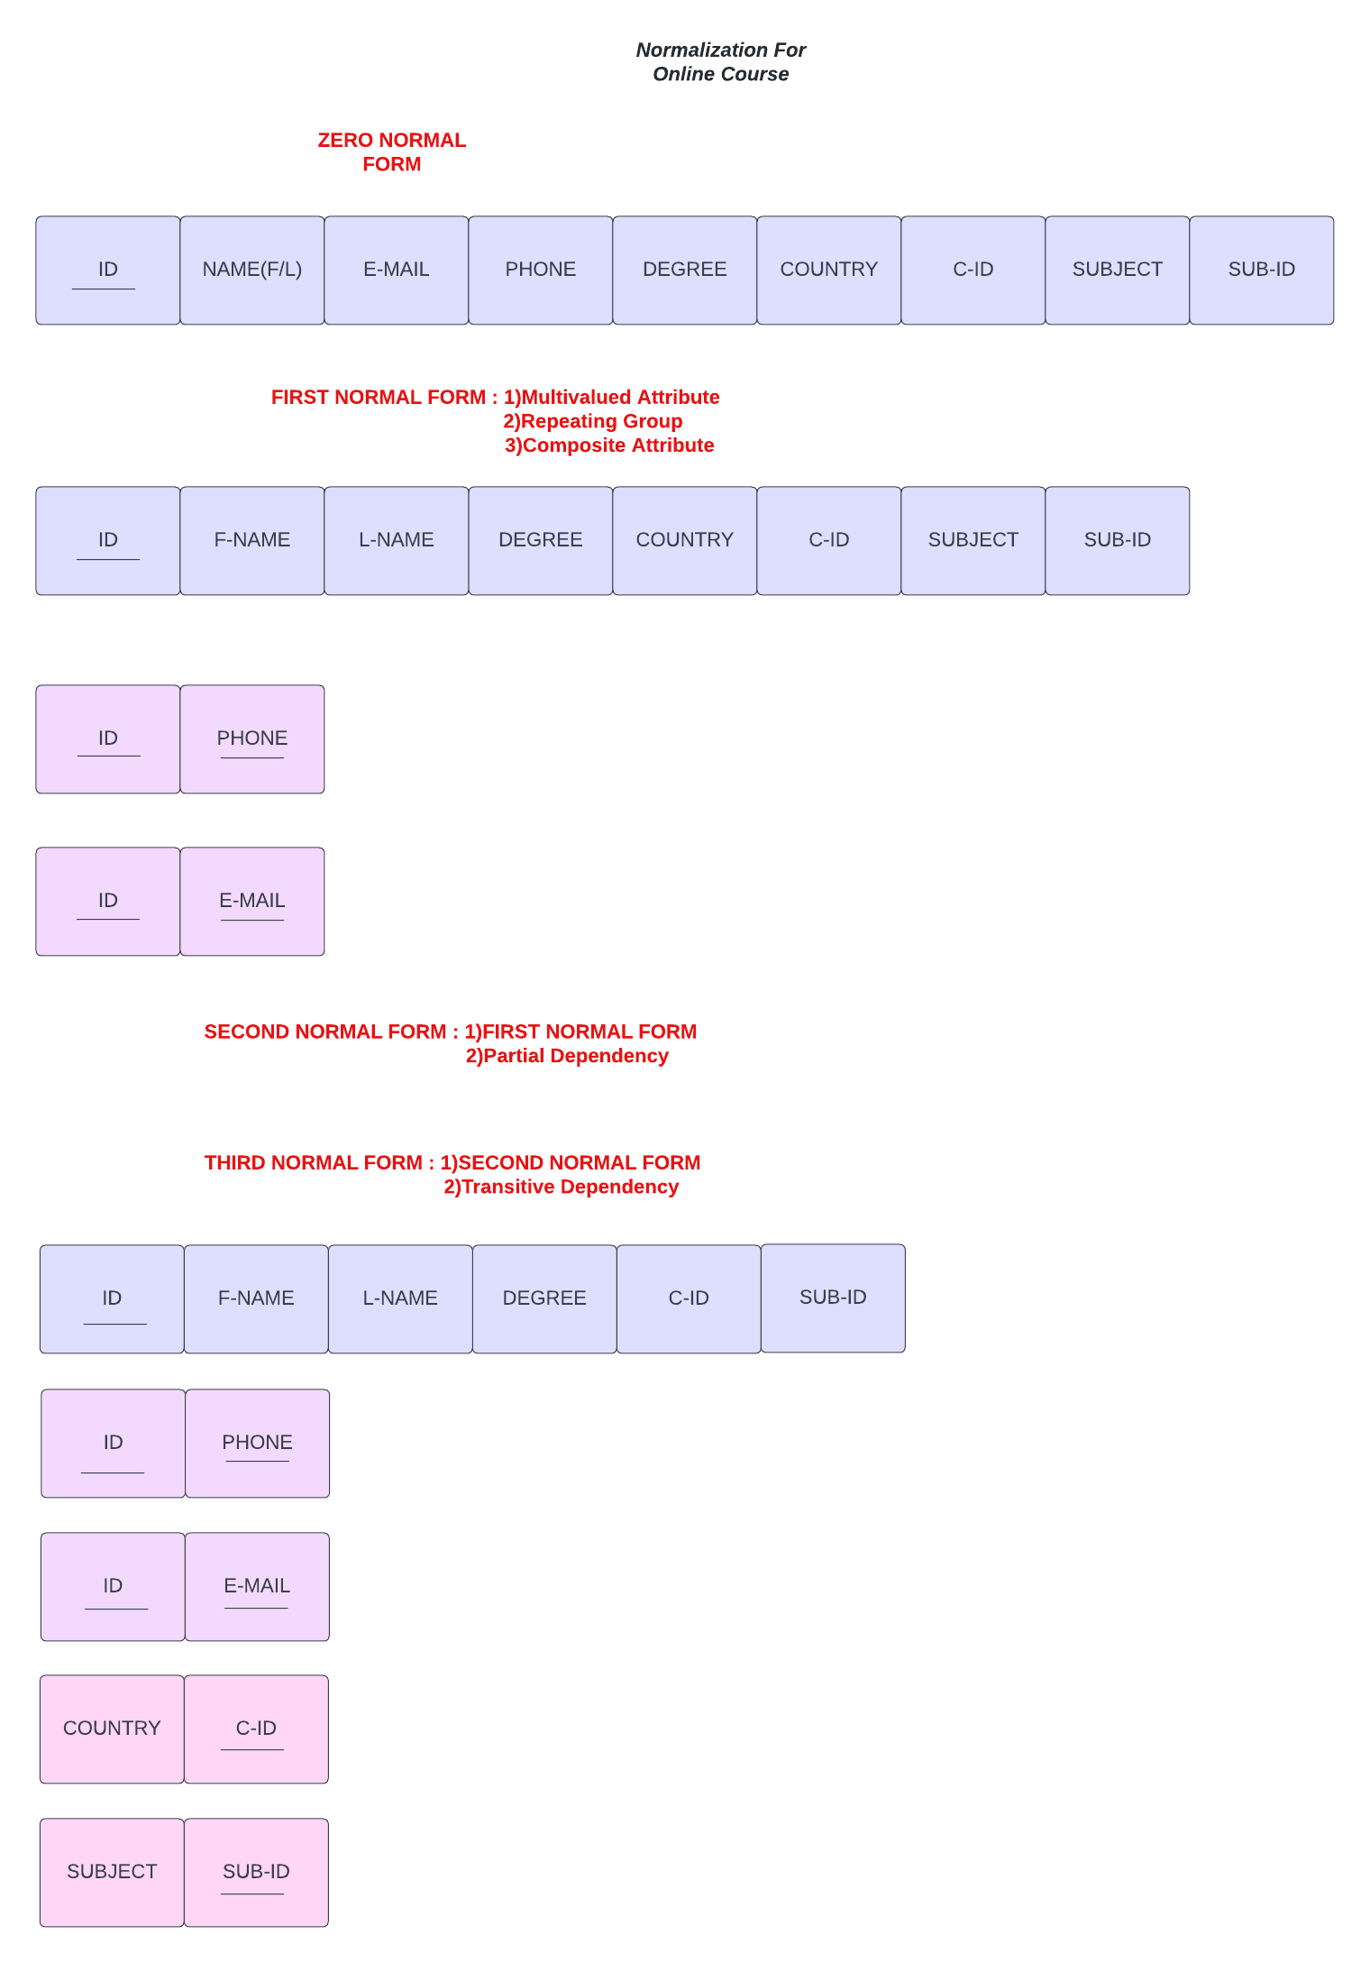
NORMALIZATION

Slide 3
BREIF DESCRIPITION
Project (Requirements or Objectives) :
1)MAKE A SUCCESSFUL COURSES APPLICATION.
2)HELP STUDENTS WHO LOOK FOR BEING BETTER IN SOME SUBJECTS.
3)NCOURAGE STUDENTS TO STUDY WITH OUR COURCE.

Slide 4
The problems your project has solved:
THE MAIN PROBLEM THAT OUR COURCE HAS SOLVED IS THE PROBLEM THAT
HAPPENED AFTER THE APPERANCE OF VIRUS CORONA AND THE EDUCATION
BECOME SO HARDER ON TEACHERS AND STUDENTS SO OUR COURCE HELPED
BOTH OF THEM TO CONTINUE THE PROCESS OF EDUCATION.

Slide 5
Project Description:
HERE IN THIS PROJECT OUR GOAL IS TO MAKE A SUCCESSFUL COURSES APPLICATION.
SO WE START WITH THE CREATING APPLICATION THEN WE GO TO SEARCH FOR BEST DOCTORS THAT THE STUDENTS PREFER THEIR METHODS IN TEACHING THEN WE START IN THE ADVERTISIMENTS STAGE HERE WE WILL PUBLISH OUR COURCE IN
EVERYWHERE THEN WE WILL ORGANIZE THE TABLES WITH DOCTORS AND
STUDENTS AND ORGANIZE THE COSTS AFTER THAT WE WILL TRY TO
DOCUMINTATION TO OUR CERTIFICATES AND OUR WEBSITE FINALLY WE TSET THE
HALL PROCESS AND TRY TO SOLVE ANY PROBLEMS.

Slide 6
MADE BY :
MOHAMED ABDELRAHMAN AHMED ELKHALAWY
MOHAMED ROSHDY TAWFIK SOLIMAN

